Slide 1



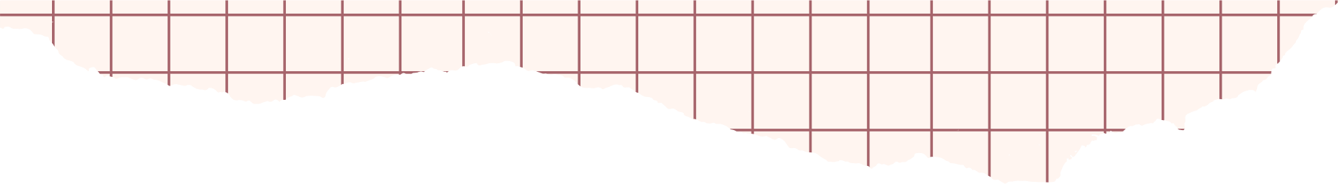



MAY 14TH 2025
DATA 205 CRN 33334
FOOD PRICES &
EXPENDITURE
Olivia Yuengling

Slide 2


Background
Over the past decade, grocery prices in the U.S. have steadily increased, with sharp spikes during 2021–2022 that outpaced wage growth.
This has raised serious concerns, especially for low-income households struggling to afford basic food.
In this project, I analyzed national data to explore how food prices have changed over time and how these shifts have impacted consumer spending across different income levels.

Slide 3

Project Goals
Investigate which food categories are the most susceptible to price spikes
Understand inflation and food price patterns from 2013-2023
Observe expenditure patterns for various income groups
Are there seasonal patterns for different food categories?
Model grocery expenditure based on other food spending behaviors
Model expenditure growth rates based on income level

Slide 4
DATA
INGESTION

Slide 5


DATASETS USED
U.S. BLS RETAIL FOOD/ENERGY PRICES:
Monthly prices on 50+ food items, from staples (milk, bread) to specialty items
Items categorized into budget vs premium as per USDA guidelines
FEDERAL RESERVE OF ECONOMICS CORE PRICE INDEX
National inflation index (excluding food and energy)
Allows comparison between broad inflation and grocery-specific spikes
U.S BLS CONSUMER EXPENDITURE SURVEY
Nationally representative data on household spending
Used to examine how different income groups spent on food
Focused on interview survey portion for detailed expenditures

Slide 6
DATA EXTRACTION + INITIAL PROCESSING
DATA PREPERATION JOURNEY
Extracted extensive data from the Consumer Expenditure Survey
Managed computer crashes due to large data volume
Refined Python code to handle the dataset efficiently
Categorized food and energy groups from Food/Energy prices
Removed irrelevant "energy" and "other" categories to focus on food items
Successfully merged CPI data with food price data by matching yearly values

Slide 7
SURVEY INTERPRETATION
Decoded complex survey notation (observations marked as "A", "B", "C")
Interpreted confusing column names with guidance from Claude and the Consumer Expenditure Survey documentation
Calculated appropriate income levels and expenditures
DATA
ADJUSTMENT
DATA AGGREGATION
Aggregated data to prevent processing issues:
Computed mean and median expenditures across food spending categories
Analyzed spending patterns for school lunch, grocery, and dining out
Organized results by income group for comparative analysis

Slide 8
DESCRIPTIVE STATISTICS
FOOD PRICES
EXPENDITURE DATA
Time span: 2013–2017
Total entries: 26,018
Only 2 missing values (excluded)
Price value range: $0.30 – $19.13
Mean core CPI: ~3.03, peaked at 8.19
Total food categories: 11
Time span: 2013–2023
Total entries: 67 observations across 7 income groups
Range of grocery spending: $53.40– $1574.33
Mean total food expenditure: up to $2487
Avg. group size: ~13,886 individuals
One null entry excluded from some calculations

Slide 9
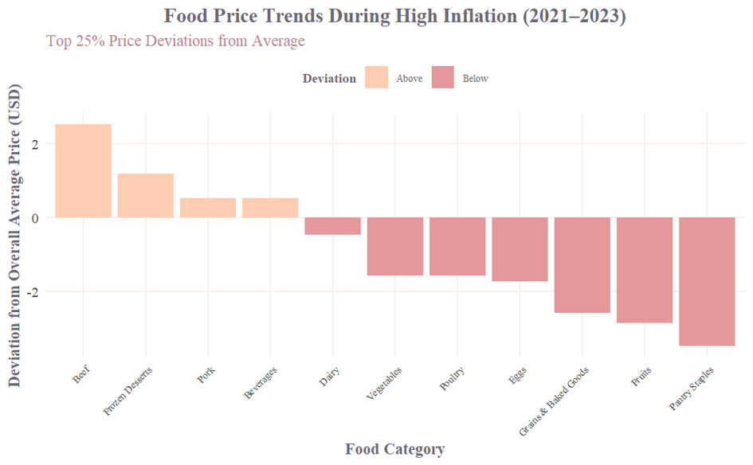
FOOD PRICE TRENDS DURING HIGH INFLATION
Categories that have a greater positive value indicate foods that have more volatile prices than other foods
Notable: beef, frozen desserts, pork
Categories with a greater negative value indicate foods with more stable prices
Notable: grains & baked Goods, fruits, and pantry staples

Slide 10
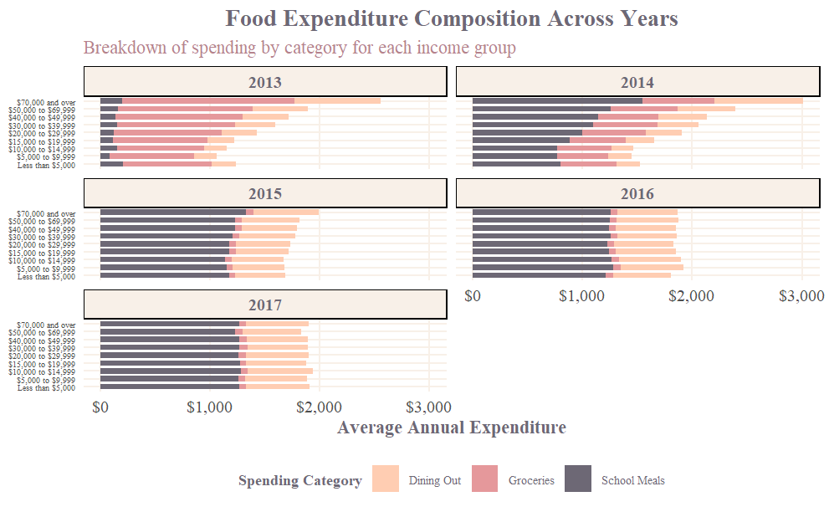
FOOD PRICE TRENDS DURING HIGH INFLATION
Higher income = more food spending, especially on dining out.
Low-income groups spend mostly on groceries.
Dining out rises sharply with income.
School meals stay minimal across all groups.
Spending patterns stay stable from 2015–2017.
Higher expenditures from 2013-2014

Slide 11
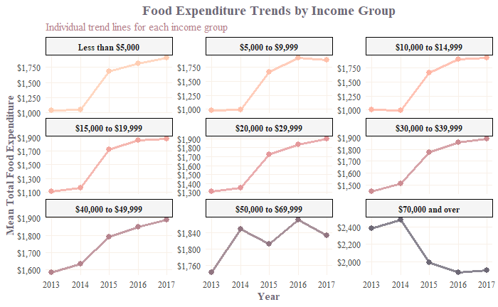
FOOD EXPENDITURE TRENDS BY INCOME GROUP
Sharp increases in 2015 across all income groups suggest a common economic shift (e.g., inflation or policy change).
Lower-income groups (<$30K) saw the largest proportional increases in spending post-2014.
Higher-income groups (> $50K) showed less consistent trends, with some dips (e.g., $70K+ drops in 2015).
Spending gaps widened slightly, showing more divergence between low and high-income groups by 2017.

Slide 12
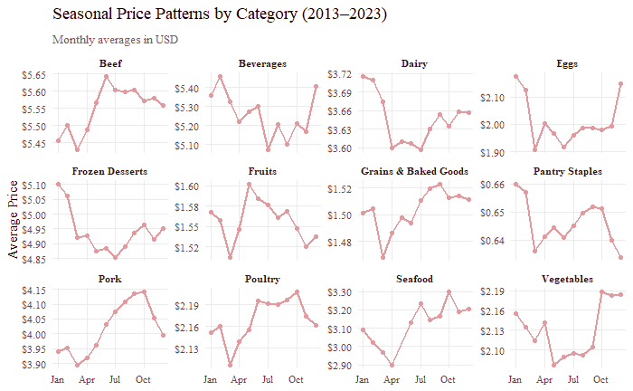
SEASONAL TRENDS BY FOOD CATEGORY
Seasonal peaks seen in Beef, Fruits, and Seafood — prices rise in summer.
Eggs and Vegetables spike at year-end, likely due to holiday demand.
Dairy and Pantry Staples show minimal seasonal change.
Pork and Poultry rise mid-year, suggesting cyclical trends.
Some items like Beverages show irregular patterns, possibly external factors.

Slide 13
Predicting Grocery Expenditure
Objective:
Can dining out and school lunch expenditures predict average grocery spending?
Dataset Includes:
Mean Grocery Expenditure
Mean Dining Out Expenditure
Mean School Lunch Expenditure
____________________________
Predictor | Estimate | p-value | Effect
Intercept | $909.66 | < 0.001 | Baseline grocery spend
Dining Out | +$0.77 | 0.003 | More dining out → more grocery spend
School Lunch | -$0.94 | < 0.001 | More school lunch → less grocery spend
Model Results:
Adjusted R-Squared of 0.78
Explains 78% in variation in grocery spending
All predictors are statistically significant

Slide 14
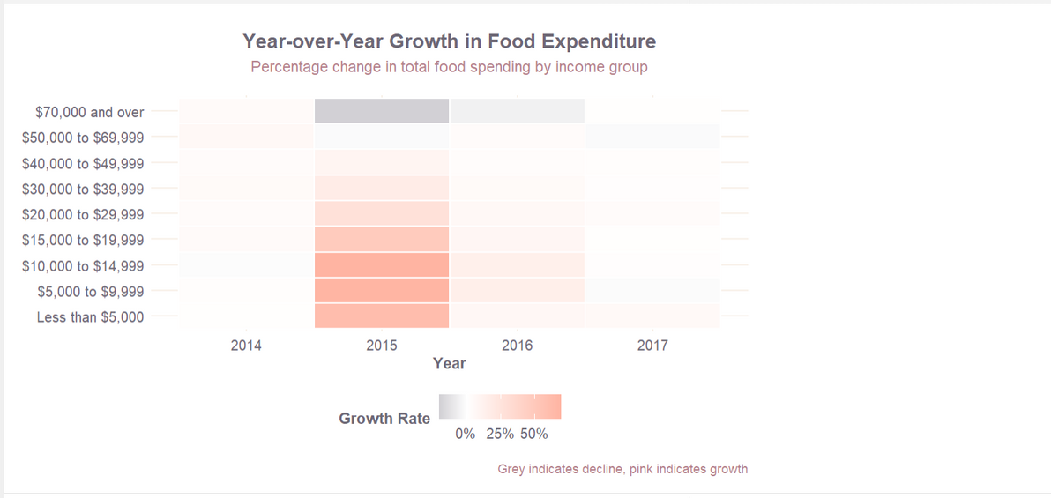
Analyzing Growth Across Income Levels
2015 Spike: Most income groups, especially lower to middle incomes, saw significant growth in food spending in 2015.
Higher Incomes: The highest income group saw a dip in spending in 2015 but grew in later years.
Moderate Growth: Upper-middle incomes generally had steady, moderate food spending growth.
Color Key: Pink = growth, grey = decline; intensity shows the rate of change.

Slide 15
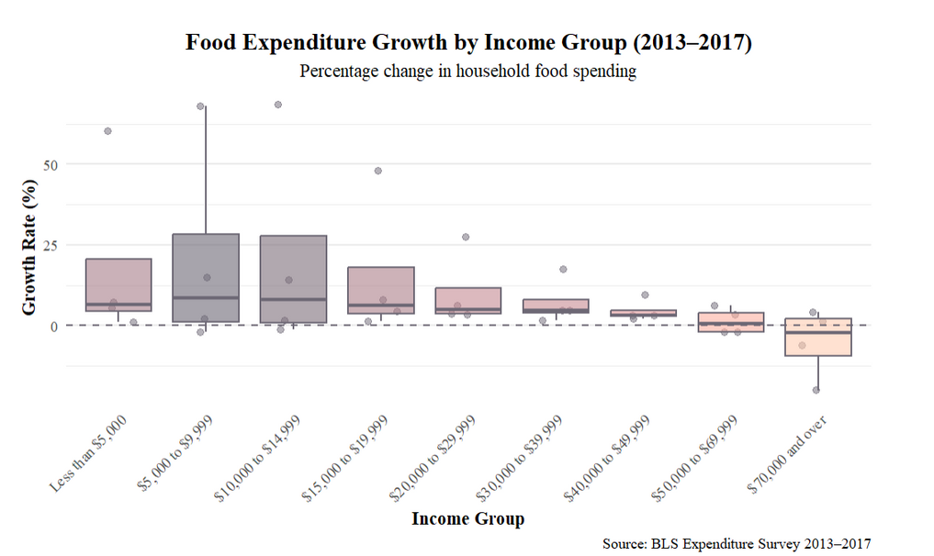
Analyzing Growth Across Income Levels
Objective:
Determine if food expenditure growth rates differ significantly by income group.
Results (Using AOV):
F-value: 0.824
Low ratio of between-group to within-group variance; weak evidence of group differences.
p-value: 0.589
Not statistically significant (p > 0.05); we fail to reject the null hypothesis.
Conclusion:
There’s no significant difference in food expenditure growth across income groups.

Slide 16
Limitations
I noticed that after 2017, the BLS stopped recording the expenditure by income, which resulted in a smaller sample for my analyses
For the seasonal food analysis, those foods were only recorded for 3 years
The CE survey does not display the exact expenditures for food (like specific types of food)
The CE survey income group of 70,000+ is too broad of a group for income

Slide 17




Slide 18
SPECIAL THANKS
Professor Perine
Professor Saidi
Professor Alraee
EC Data Science Cohort
Audience Members

Slide 19
Sources
U.S. Bureau of Labor Statistics. (n.d.). Consumer Expenditure Surveys. Retrieved May 13, 2025, from https://www.bls.gov/cpi/data.htm
U.S. Bureau of Labor Statistics. (n.d.). Consumer Price Index for All Urban Consumers: All Items Less Food and Energy in U.S. City Average [CPILFESL]. FRED, Federal Reserve Bank of St. Louis. Retrieved May 13, 2025, from https://fred.stlouisfed.org/series/CPILFESL
Ritz, R. (n.d.). Average Price Data (BLS) [Dataset]. Kaggle. Retrieved May 13, 2025, from https://www.kaggle.com/datasets/robertritz/average-price-data-bls
Coding Assistance: ChatGPT

